Slide 1
FHIM Overview FHIM Approach to Modeling

Slide 2
Background: FHIM
A logical health information model that supports semantic interoperability. It is built by harmonizing data requirements from Standards Development Organizations and the Federal partners
Goal is to establish a comprehensive, integrated set of standard “implementation guides” that fully support semantic interoperability and implementable artifacts in the various standards
The business/clinical requirements of patient data is the same regardless of whether it is implemented in HL7 v2 EDI, V3 XML, or FHIR JSON.
Has both structural and terminology components. FHIM coded concepts are “bound” to terminology in a separate FHIM Terminology Model via mechanisms adapted from MDHT
FHIM is a both a Logical Information Model (LIM) and a Platform Independent Model (PIM)
FHIM is aligned with both the HL7 Reference Information Model (RIM) and with FHIR
Notes:
Please use the slide construction guidelines included on the next slide within your presentation.

Slide 3
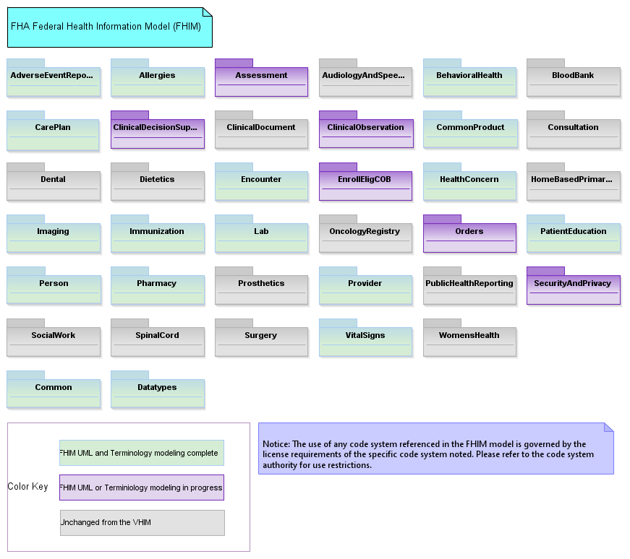
The FHIM Main Diagram

Slide 4
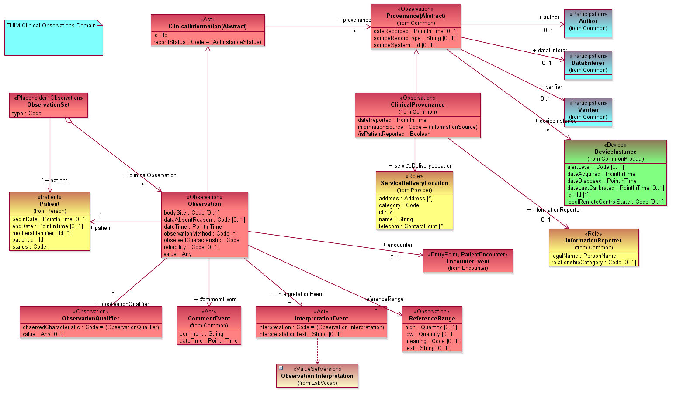
FHIM Clinical Observation

Slide 5
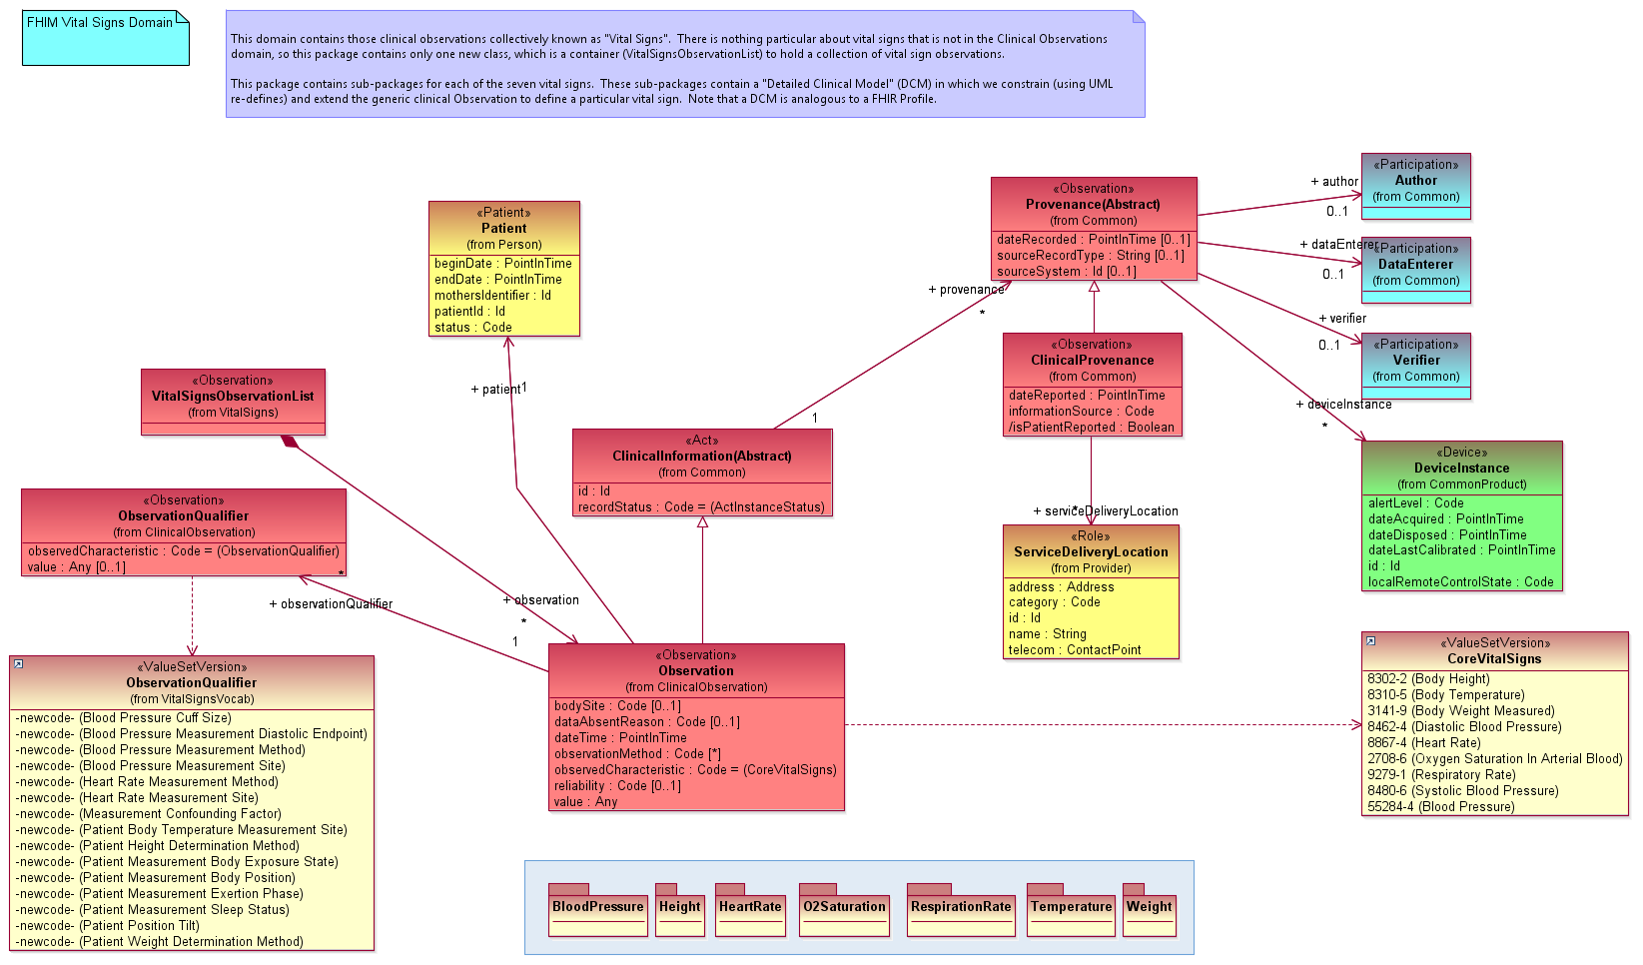
FHIM Vital Signs

Slide 6
FHIM “Detailed Clinical Models”
The FHIM primarily models generic structures like “Vital Signs”, which can accommodate any Vital Sign
Consistent with the approach of most standards
But we can create DCMs using UML “re-defines”
A re-define allows one to constrain a UML model by re-defining in a sub-type a property that was introduced in its super-type
The following slides show the Heart Rate DCM

Slide 7
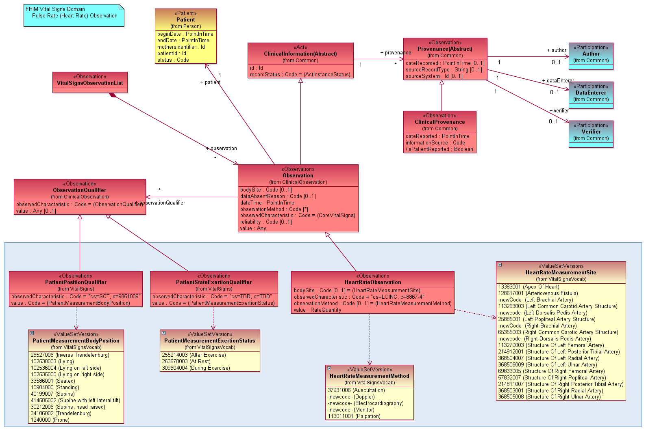
FHIM Vital Signs: Heart Rate

Slide 8
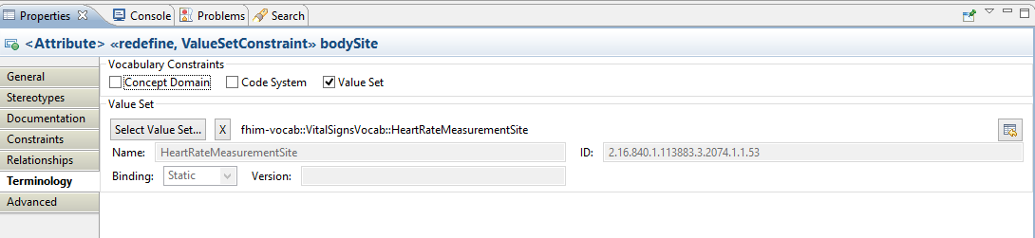
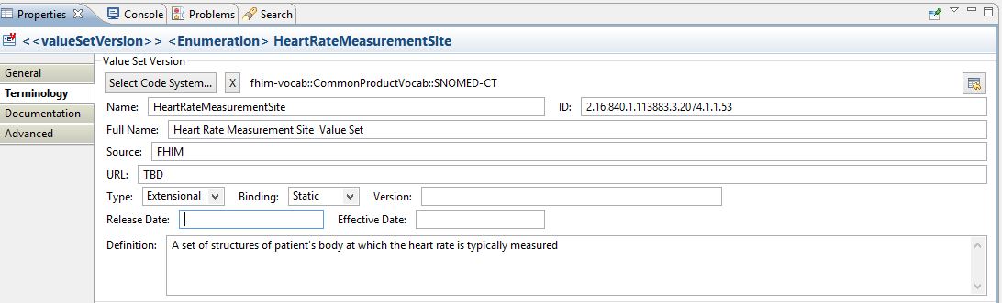
Terminology binding in the FHIM
Once the value set is created VSAC, this will point to the page where it can be viewed

Slide 9
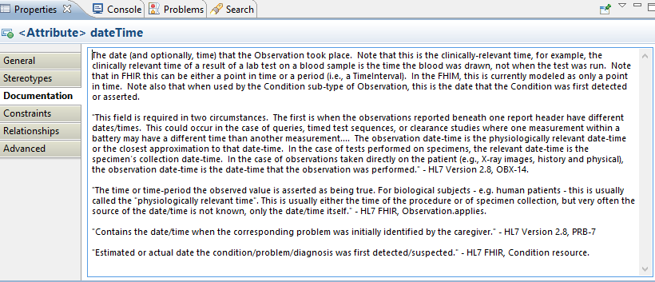
Documentation

Slide 10
FHIM “Detailed Clinical Models”
We have demonstrated how DCMs can be modeled in the FHIM
But, while we “hand-built” the Vital Signs DCMs, we do not envision doing so going forward. We contend that the majority of DCMs should be generated from a knowledge base (i.e., CIMI)
Each DCM represents a set of possible values in the “code” and the “qualifiers” that could be related to post-coordinated concepts in a medical ontology (e.g., SOLOR).
Once generated into UML, the FHIM could then be used to generate implementable artifacts in multiple standard formats (e.g., FHIR, CDA, etc.)

Slide 11
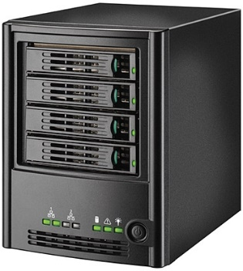
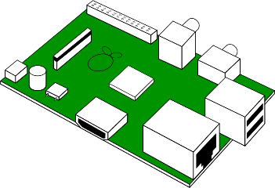
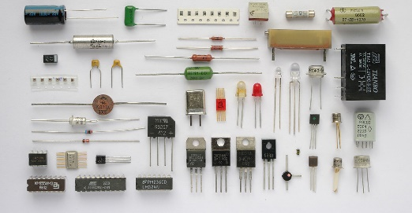
A notional “hierarchy” of models
FHIM models the
overarching system
i.e., provides context
for the “components”
FHIR profiles,
CDA Sections,
V2 Segments
(also modeled in FHIM)
CIMI DCMs
(knowledgebase)

Slide 12
Benefits to HSPC
The FHIM provides the “missing logical model,” the absence of which hinders some standards individually, and the corpus of standards to which organizations must comply
In combination with MDHT, the FHIM can generate service payloads, both at the coarse grained level (e.g., Vital Signs) and at the fine grained level (e.g., Heart Rate)
Those payloads can be expressed in standard-compliant formats, e.g., a FHIR JSON instance, or an HL7 v2 message.
Other code can be generated, including code to test conformance of the payloads

